Slide 1
School surveys
by class 7.a (2024/25)

Slide 2
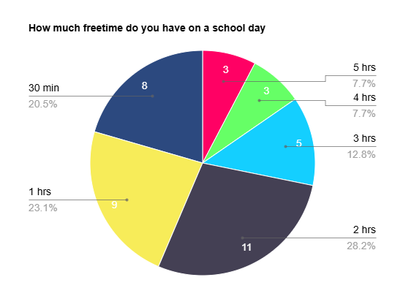
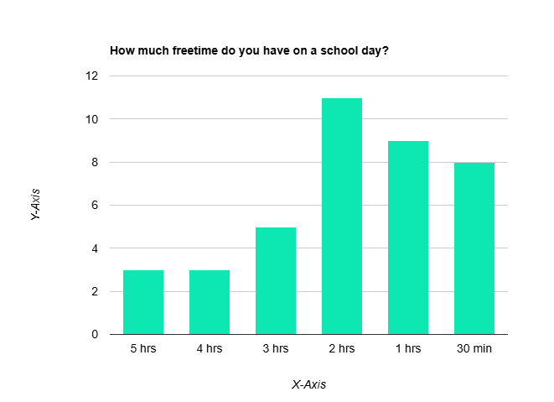
How much freetime do you have on a school day?
Almási Laura, Csíki Flóra
We asked one question about how much freetime students have on a school day. We asked 40 people. We asked the students of the upper primary school. We asked 10 people from each year.
These are the results of our survey:
Most of the people said they have 2 hours of freetime. Less than half of the people said they have 1 hour for relaxing. 8 people said they have got 30 minutes. A few people said they have got 5 or 4 hours of freetime. 5 people said they have got 3 hours.
As we can see most of the people have got less freetime than you think.

Slide 3
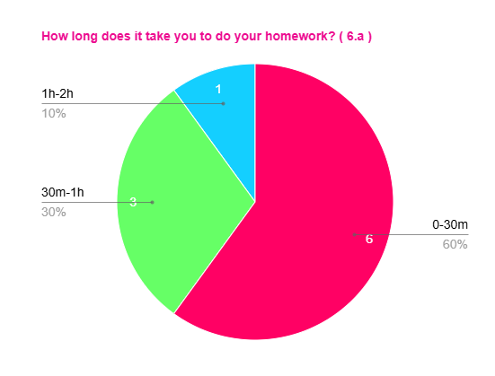
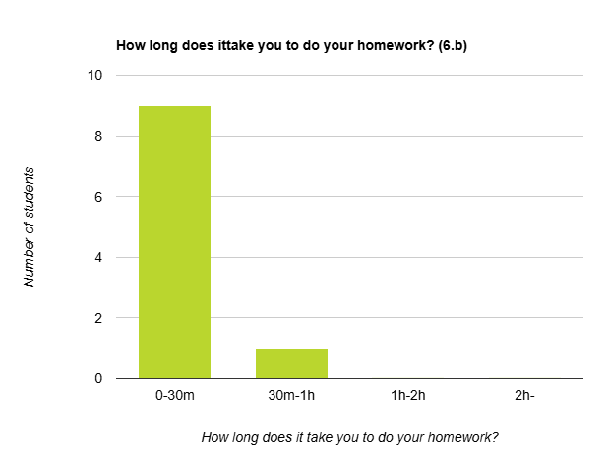
How long does it take you to do your homework?
Kajtár Emma, Kerner Liza
We asked ten people from three different classes, but they are all in the 6th grade.
First, we asked class 6.a: More than half of the people in the class said in between zero and thirty minutes. Some people said in between thirty minutes and one hour and only one person said in between one and two hours. But no one said more than two hours.
The second class we asked was 6.b: Almost everyone said in between zero and thirty minutes. But one person said more then thirty minutes.

Slide 4
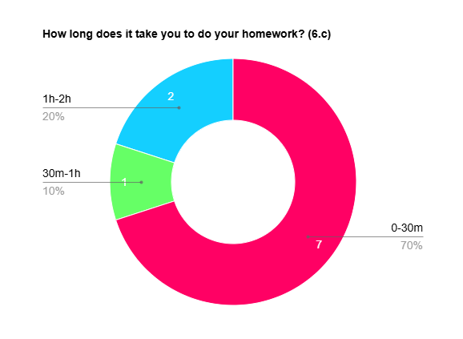
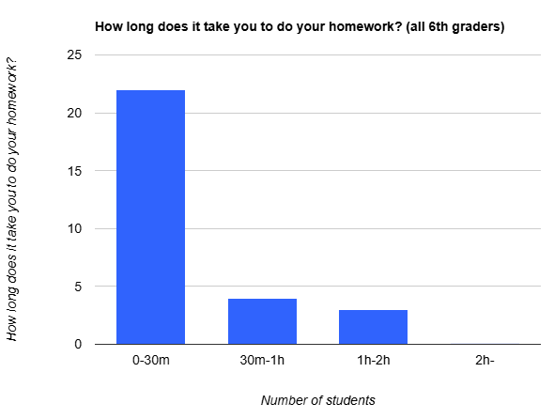
The last class we asked was 6.c: Lots of people said in between zero and thirty minutes, but one person said in between thirty minutes and one hour, and two people said more than an hour.
As you can see doing homework in year six doesn’t take that much time as you think (only for a few people).

Slide 5
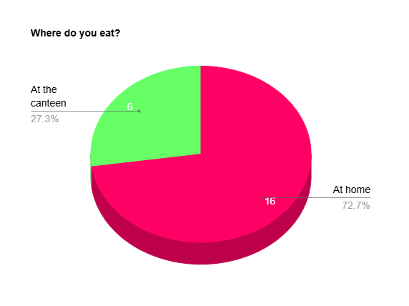
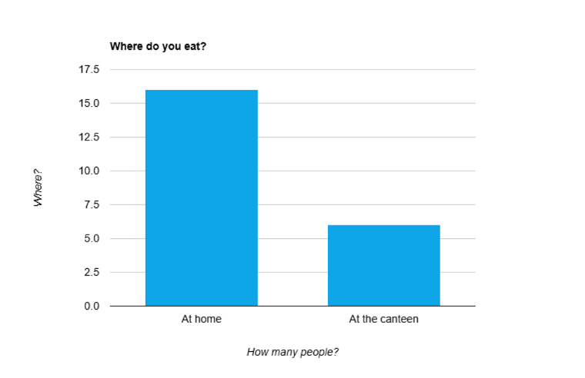
Where do you eat?
Bogyó Balázs, Csiszér Andor
We asked 22 people, so our whole class was in this survey. These are the results of our survey.
More than quarter of, but less than half of the people eat here in the school canteen. The rest of the people eat at home. So, 6 people eat here, and 16 people eat at home.

Slide 6
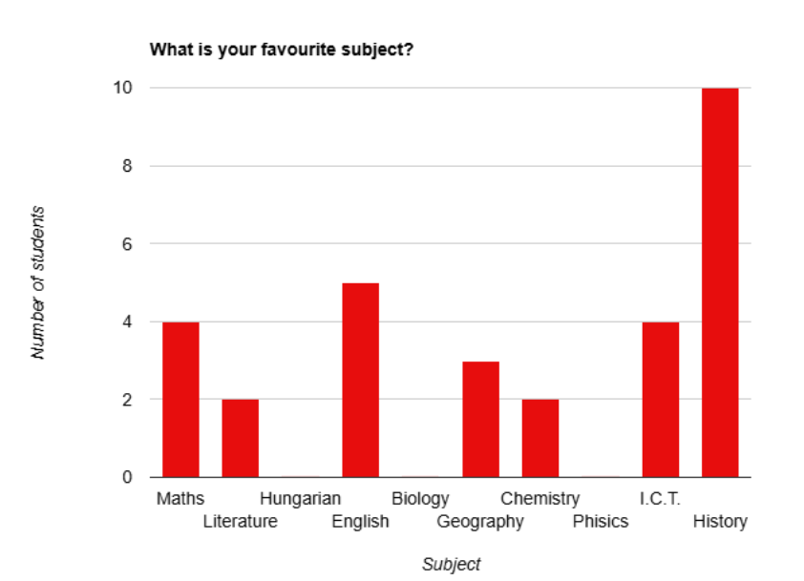
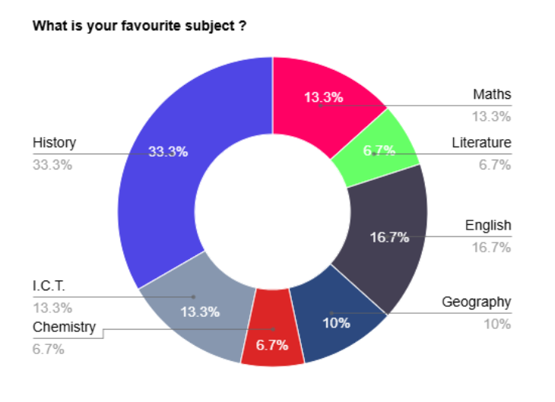
What is your favourite subject?
Boldizsár Bertalan, Borbás Hunor, Gyurák Dávid
We asked the question: What is your favourite subject? We asked a total number of 30 students from our school.
History is the most popular, one third of the students voted for it. The second most popular is English with one sixth of the votes. The third most popular is a tie between Maths and I.C.T. Nobody voted for Physics, Hungarian and Biology. Only a few people voted for Chemistry and Literature with only one fifteenth of the votes. Less than quarter of the people voted for Geography.
So, we can see that History teachers are in a very good position, but sadly Hungarian and Biology teachers don’t enjoy much success.

Slide 7
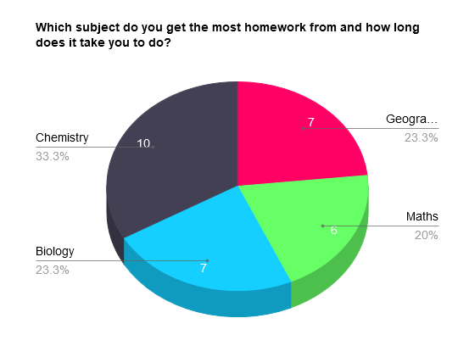
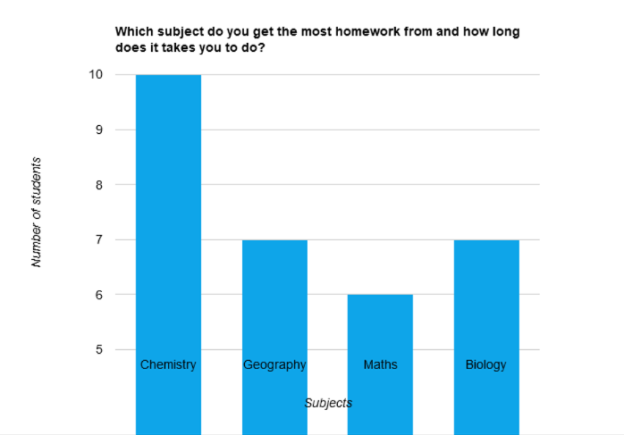
Which subject do you get the most homework from and how long does it take you to do?
Birkás Vince, Bősz Kristóf
We asked 30 people from our school about what the classes are where they get the most homework and how long it takes them to do it.
One fifth of the 30 people said Maths. The average time to do it was 30 minutes.
7 people said Geography and it takes them 35 minutes to do it.
The same amount of people said Biology, but on average it takes them about 40 minutes.
One third of the people we asked said Chemistry and on average it takes them a rough number of 1 hour.

Slide 8
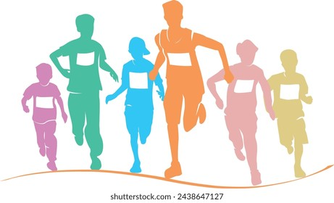
So, if they have a hard day when they have all of these classes, they have to spend about 2 hours and 45 minutes on their homework. I think that’s a lot of time. In that time you could run the marathon if you are fit enough.

